Slide 1
Blockchain Technology

Slide 2
D-Gen Squad
A New Beginning of Digital Generation …

Slide 3
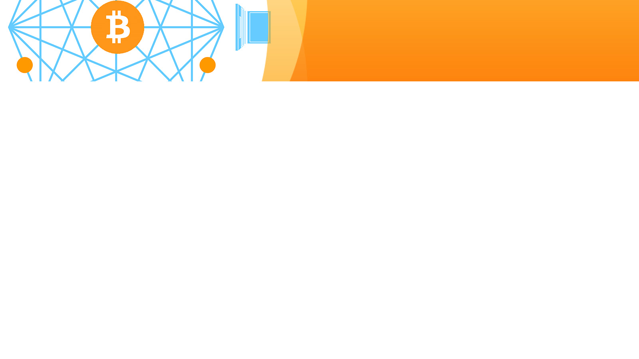
Presentation Date: 01/02/2025
Group Head: Sumama
Group Members: Bilal, Aima and Bisma
BS CS – Fall 2024
Application of ICT

Slide 4
Who we are?
We are Blockchainers…

Slide 5
Outlines
Introduction to Blockchain
Impact on society
Advantages
Disadvantages
Types of Blockchain
Conclusion
QnAs

Slide 6
Introduction to Blockchain
Open and distributed ledger to record all the transactions b/w 2 parties.
Series of connected nodes
Info will be with every node
Cryptography representation of data

Slide 7
Introduction to Blockchain
Decentralized, AKA DLT
In the list of IBAC
Verifiable and permanent transactions which builds trust

Slide 8
How it works?
Collect all transection’s record in a block
Each block is connected with previous and next block
Each transection/record is encrypted with SHA-256 Algorithm
Each block contains Nonce, Prev Hash and all trx with hash

Slide 9
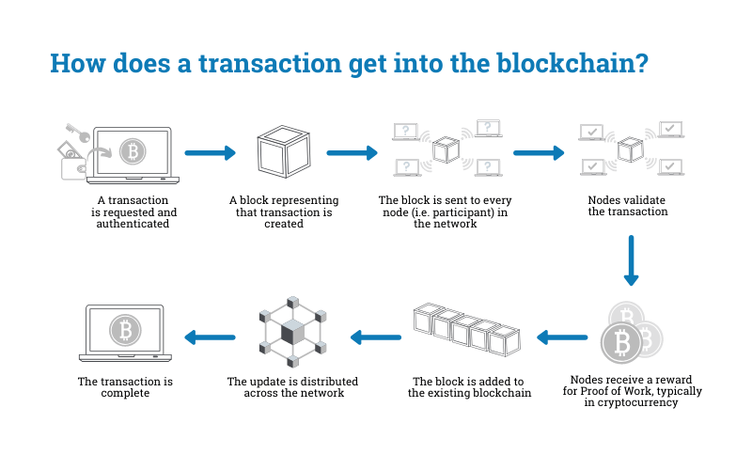

Slide 10
Impact on society…
Builds trust on internet b/w every user, also real life trust
New opportunities – as a consultant, smart contract dev, analyst, lawyer, policymaker, programmer, security engineer, game dev, web3 dev, games analyst, architect, PM, etc.

Slide 11
Impact on society…
Economic Impact
DeFi, Generates new business models (token-based and decentralized marketplaces)
Social Impact
eID, Voting, Supply chain, Gamings
Environmental Impact
Sustainable energy, waste management
Governmental Impact
Regulation, policy, legal formalities

Slide 12
Impact on society…
~ 55% of global orgs see BC as a strategic priority.
~ 35% + companies are in the dev stage of BC.
Global spending on BC solutions: ~ US$3B in 2019, US$12B in 2022, in 2023 $14B, $20B in 2024, and expected ~$40B in 2025.
US accounts around 50% of global BC investments, China follows.
There are more than 10K startups on AngelList (Company) only.

Slide 13
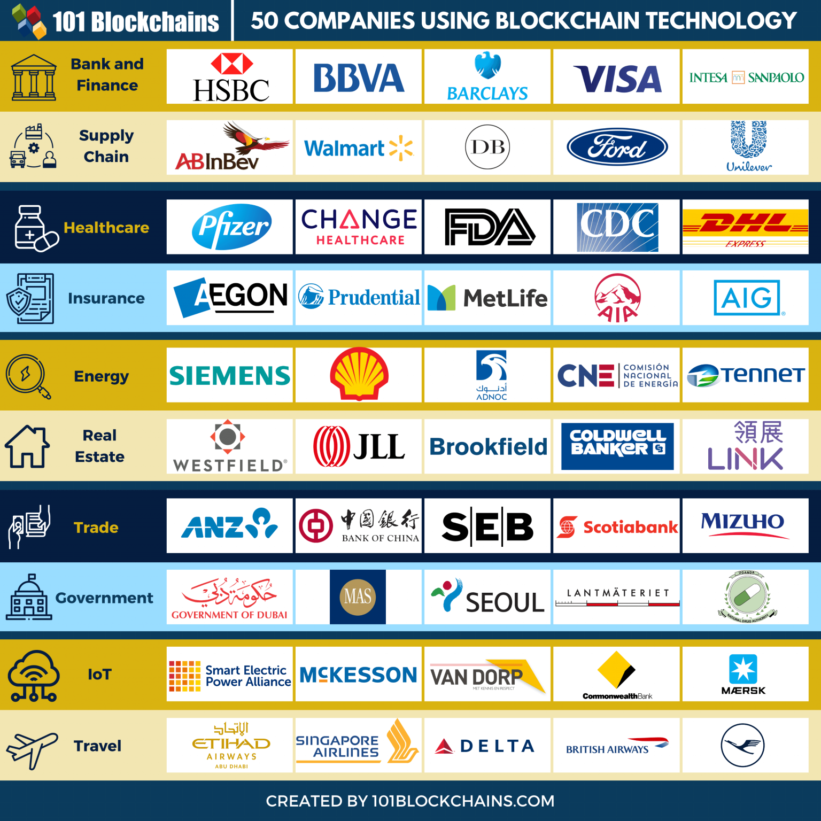

Slide 14
Advantages
Decentralized (No third parties involved)
Immutability and Permanent
Traceability
Transparency and Privacy (e-ID, Money etc.)
No altered and tempered data etc.

Slide 15
Advantages
Efficiency and Speed
Secure, No hack no crack etc.
Verifiable and Trustable
R and W only no reverse or D or U option like other DBs (use CRUD operation)

Slide 16
Disadvantages
Slow in speed and Scalability issues
High implementation cost (some times it is disadvantage)
More node joins then speed will slow down more
Power Consumption, Processing power and Time
Regulations issues and Legal Formalities
Double spending and bad smart contract issues
Storage (every node/touch point need to upgrade his/her storage size)

Slide 17
Types of Blockchain
Three types mainly: Private, Public and Hybrid ( and consortium)
Anyone can join any blockchain network
You need only a Node

Slide 18
Types of Blockchain
Three types mainly: Private, Public and Hybrid ( and consortium)
Anyone can join any blockchain network
You need only a Node

Slide 19
Interested! Show me a demo please...

Slide 20
Demo
How Hash function works/generated?
How Blocks are mined and store data?
How Blocks are formed?
How Blocks connected each other?

Slide 21
Conclusion
Other than these few examples, the revolutionary technology of Blockchain holds a high potential of applications in many different industries and sectors.
Healthcare, Supplychain, Education, Finance and Banking, Gov, Cryptocurrancies, Travel and Transportations, IoT, Escrow, Land records, Courts (criminal and all other records), Commerce (even though local shops are included), Vehicle registration, Birth/Death Certificates, Voting, Trading, Passports (e-ID) etc.

Slide 22
Do you have any question?

Slide 23
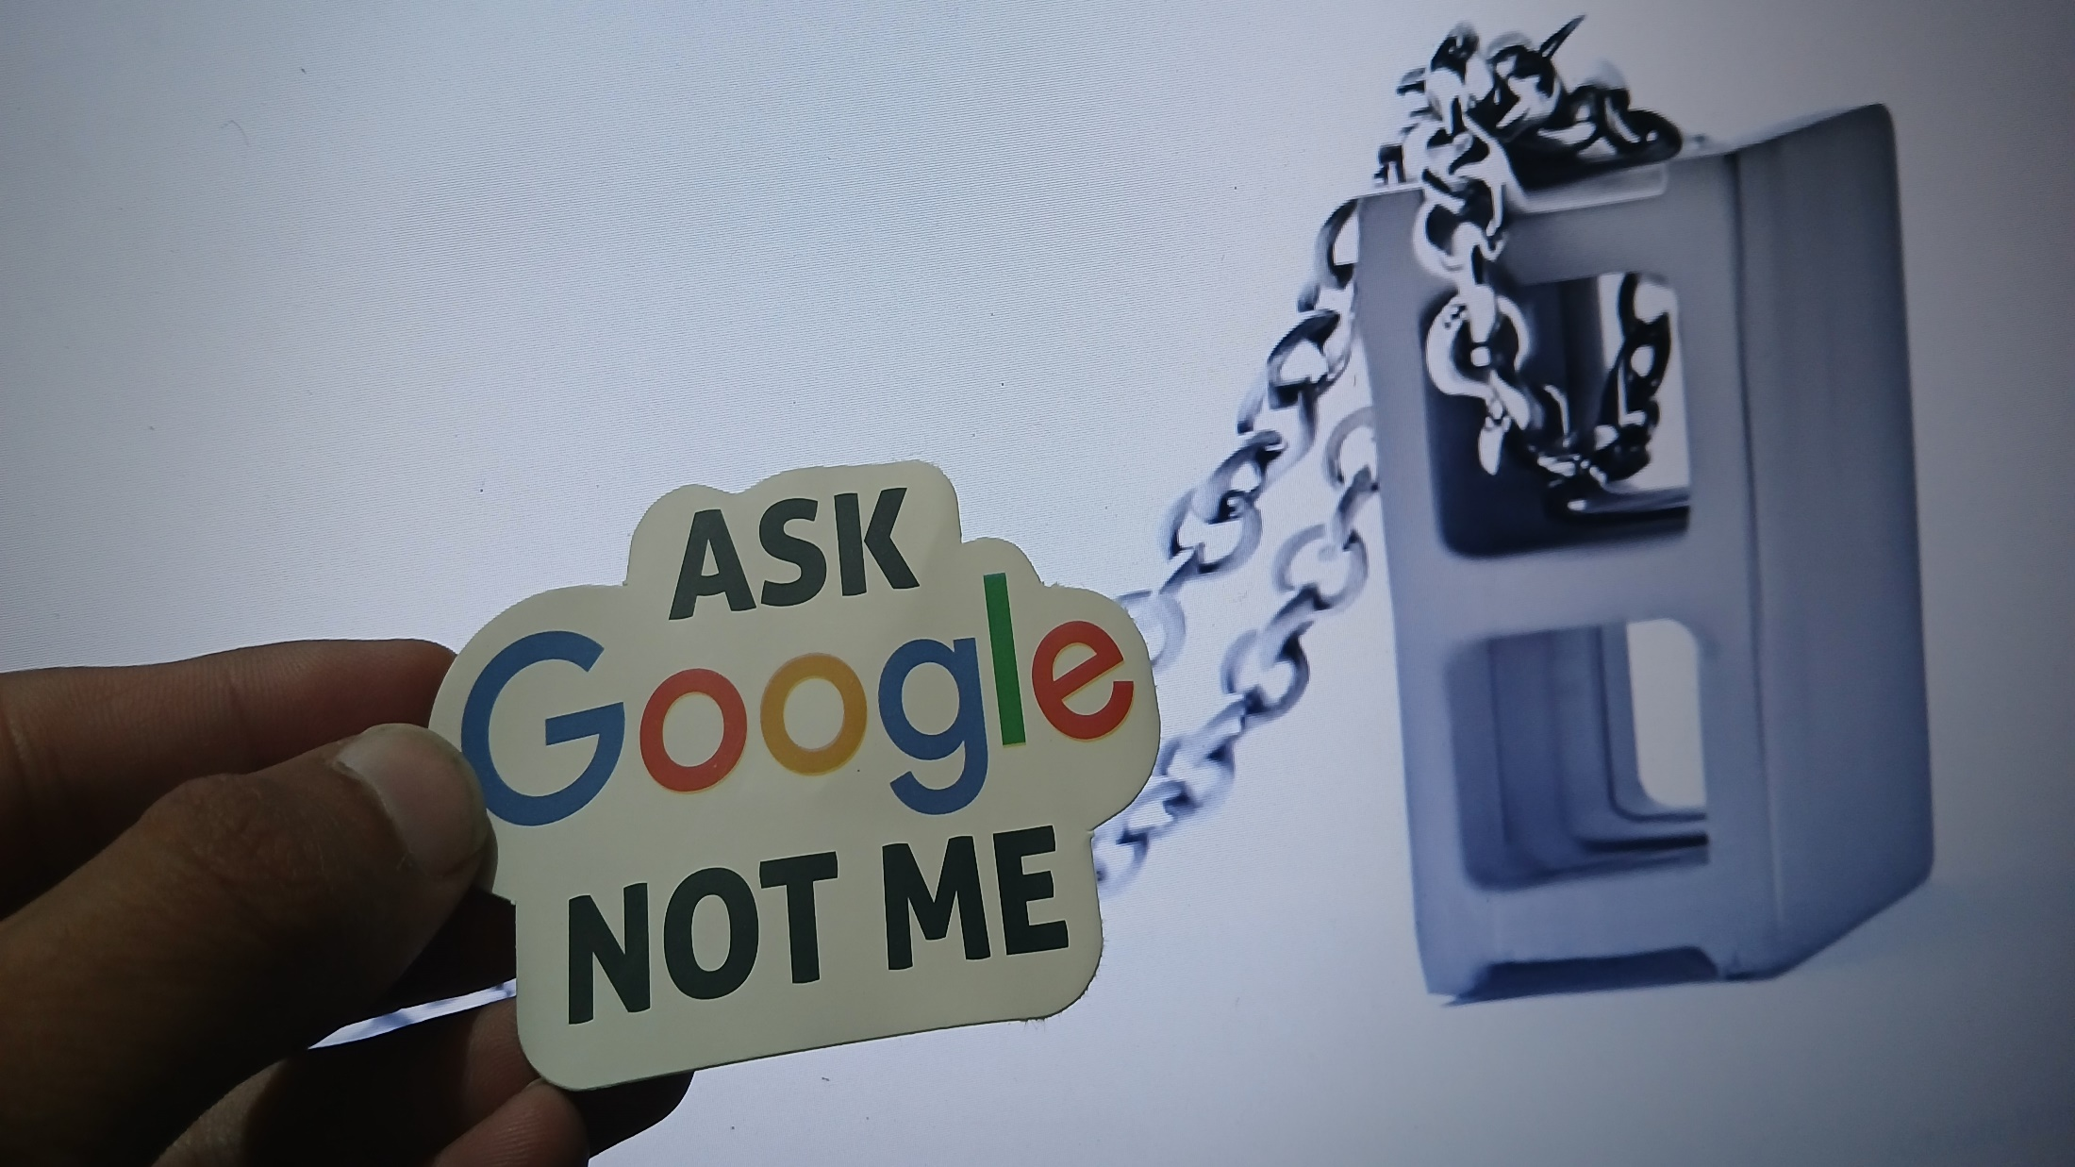

Slide 24
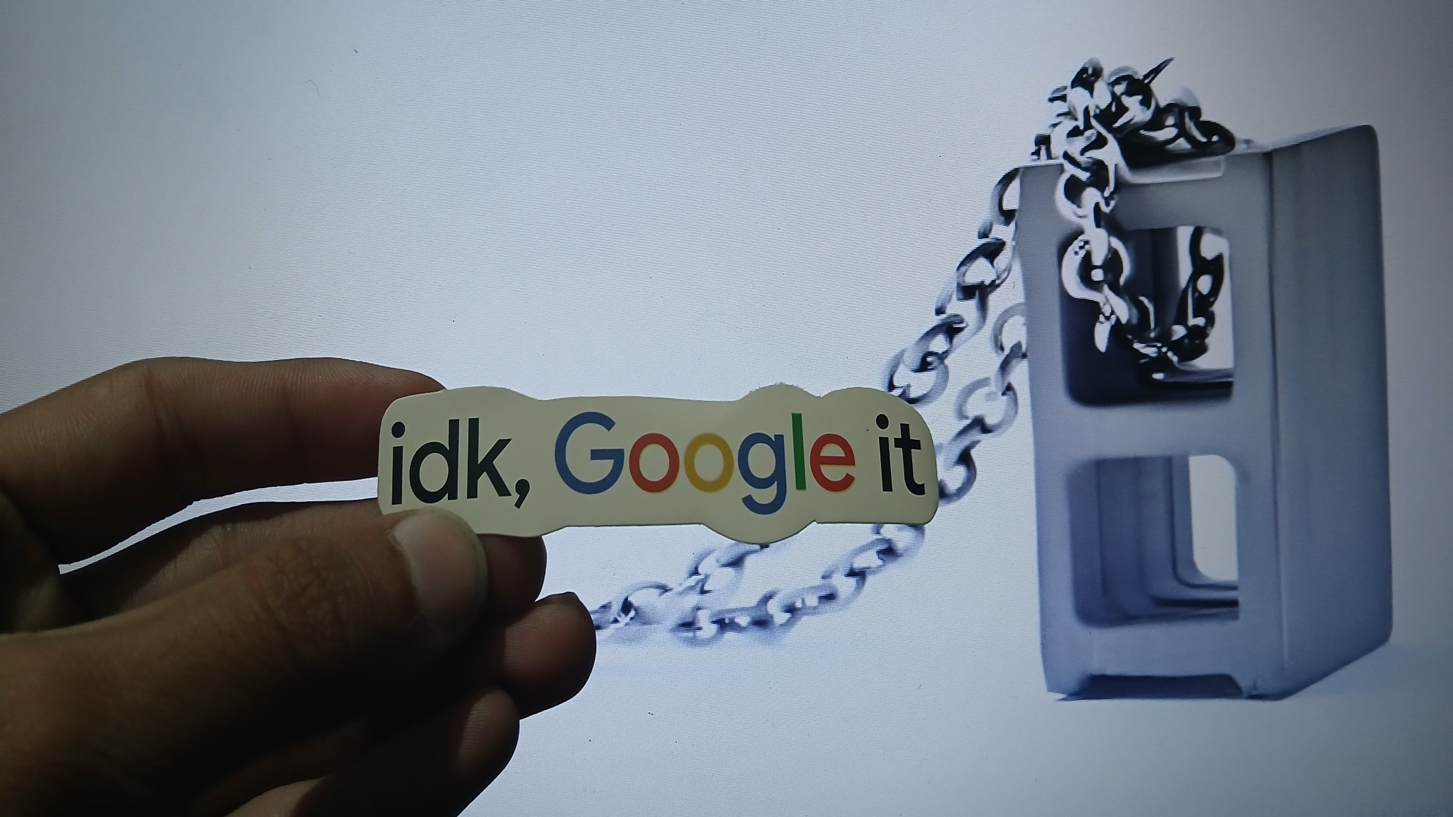


Slide 25
Contribution
Content QA By:
Sumama Rahim (F24BSCS039)
Slides Designed By (Used Readymade Template):
Muhammad Bilal (F24BSCS047)
Content Gathered By:
Bisma Mahmoud (F24BSCS034)
Aima Tur Rehman (F24BSCS021)

